Slide 1
Kirchhoff,s Laws

Slide 2
Kirchhoff,s Laws
• Kirchhoff's laws shows us how to find voltage and current in circuits with many components
• We can easily find the equivalent resistance of a complex network
• Both AC and DC circuits can be solved and simplified by using these simple laws
Kirchhoff's laws
Voltage Law (KVL)
Current Law (KCL)

Slide 3
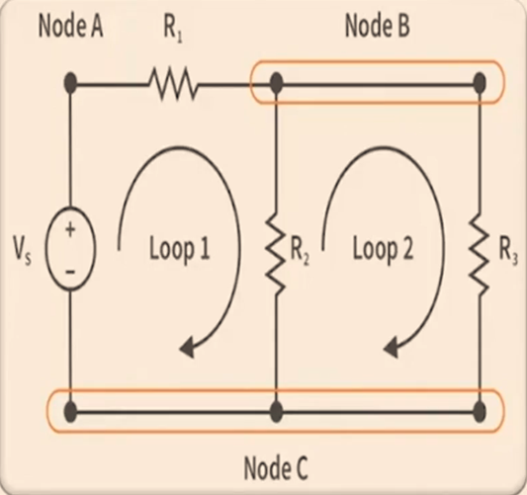
Circuit Definitions
Branch : A circuit single element
Node : It is point of connection of two or more branches
Loop : Any closed path in a circuit
Network : Interconnection of elements or devices
Circuit : Is a network providing one or more closed paths

Slide 4
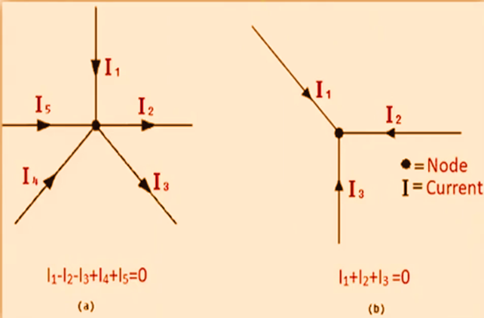
Kirchhoff's Current law(KCL)
• Total current entering a junction is equal to the total current leaving the junction.
Or
• The algebraic sum of the currents at the junction (node) will be zero.
This is an outcome of the principle of the
conservation of electric charge

Slide 5
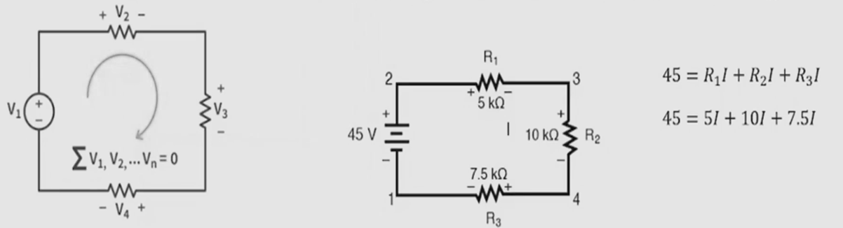
Kirchhoff’s Voltage law
• States that the algebraic sum of voltage drops in a closed loop is zero
• The algebraic sum of the EMF applied is equal to the algebraic sum of the voltage drops in the elements
• It is very important to determine the direction of current whenever solving circuits via kirchhoff's laws.
This idea by Kirchhoff is known as the Conservation of Energy.

Slide 6
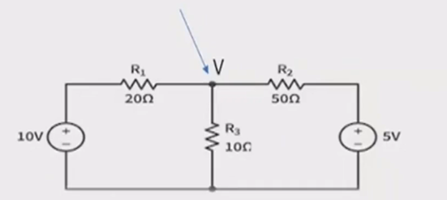
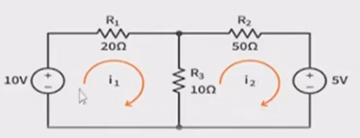

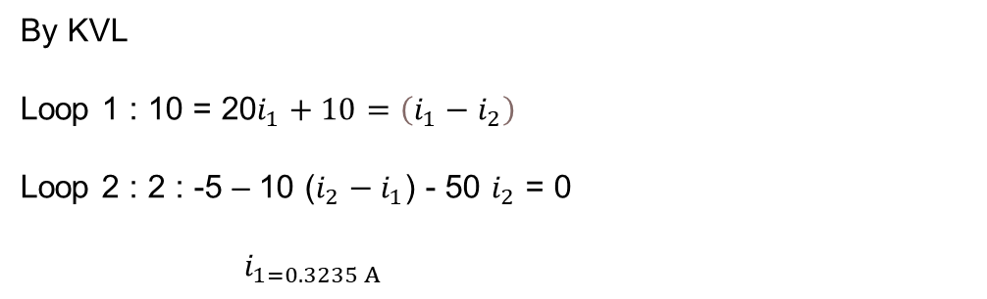
Example
By KVL
Loop 1 : 10 = 20$i_{1}+10=\left(i_{1}−i_{2}\right)$
Loop 2 : 2 : -5 – 10 ($i_{2}−i_{1}$) - 50 $i_{2}$ = 0
${ i}_{1=0.3235 A}$
By KCL
$$\frac{v−10}{20}+\frac{v}{10}+\frac{v−5}{50}=0$$
$$v=\frac{60}{17}v$$
$${ i}_{1=0.3235 A}$$

